Slide 1
WELCOME TO SEBA
Brain Teaser:
There is a special kind of ropes made from some non-homogeneous material. Because of this special material, the rope takes exactly one hour to burn if lighted from one end. However, as the material is not uniform across the rope, different parts of rope may take different amount of time. So for example, one half may take 1 minute where as the other half may take 59 minutes to burn. You are given two such ropes how do you measure 45 minutes?

Slide 2
Solution
We have two ropes A and B. Light A from both the ends and B from one end. When A is finished burning we know that 30 minutes have elapsed and B has 30 minutes remaining. Now, light the other end of B also so that remaining part of B will burn at double speed taking 15 minutes to burn. Thus, we have got 30+15 = 45 minutes.

Slide 3
WELCOME TO SEBA 2013
What is SEBA?
  Science and Engineering Business Association
  Formed in spring 2010
  Allow non-business majors to stay in touch with business world
  Network and learn from other student with similar interests
  Prepare for internships and target career

Slide 4
Stock Competition
1) Julian
  SYNNEX Corp. – Agreed to buy IBM’s customer care business for $505 million
2) Jessica
  Freddie Mac – Attracting attention of marquee investors
3) Samantha
  Velti PLC – Provider of mobile marketing and advertising technology

Slide 5
Current Events
Dow Jones: 15,494.78 (+0.77%)
Gold: 1,317.80/troy ounce (+0.70%)
Oil: 106.59/barrel (-1.50%)
Natural Gas: 3.74/million BTUs (+1.7%)
Price of natural gas rose 1.7% yesterday
  Speculation that supply will have smaller than normal increase due to the hot weather in the Midwest.

Slide 6
Summer’s Withdrawal
Lawrence Summers withdrew from contest to succeed Ben Bernanke as Chairman of the Federal Reserve
Bernanke does not want to serve a third term
Dow Jones up 0.77% yesterday
What would happen if he got position?
  Expected to quickly wind down Fed’s quantitative easy.
  Going to stop eventually but other candidates expected to run it longer
    Janet Yellen (Fed Vice Chairman)
    Donald Kohn (Former Fed Vice Chairman)

Slide 7
Ex-JPMorgan Employees Indicted
Attempted to hide over a $6.2 billion trading loss
JPMorgan has to pay over $750 million fines
A trader at JPMorgan who had accumulated a position so big it was affecting the whole market, prompting some hedge funds to make large opposing bets.

Slide 8

RESUME WRITING
Presenting Yourself on Paper

Slide 9

Workshop Agenda
Purpose and Impact of a Resume
General Guidelines
Key Components
Optional Categories
Resume Formats
Resume Check List
Follow Up

Slide 10
Purpose and Impact

Slide 11
Purpose and Impact
Marketing Tool
  Designed to create a favorable first impression
  Made to get you an interview, not the job
Personal Account of Your:
  Education and Training
  Experience
  Skills and Abilities

Slide 12
Purpose and Impact
Provides an accurate, concise, and original presentation of who you are
Resource for employer at interview
Remember: Employers spend 4 - 5 minutes at most reviewing a resume. Make each word count!

Slide 13
Guidelines

Slide 14
General Guidelines
Length
  Generally one page, one-sided
Layout
  Direct reader’s eye using headings and layout
  Choose standard font in 10-14 point size
  Use high quality 8.5” x 11” paper
  Consider the aesthetics of resume format and avoid a 'cluttered' look

Slide 15
General Guidelines
Layout continued
  Be consistent with:
    Indentations
    Capitalization
    Font
    Spacing

Slide 16
General Guidelines
Content
  Proofread! Don’t rely on spell-check
    grammar
    spelling
    typographical errors
    punctuation
Stress accomplishments and results (STAR method)
Tailor contents to each position (e.g. rewrite Objective/revise Skills section)

Slide 17
Key Components

Slide 18

Resume Key Components
Title and Heading
  Your name
  Current address and home address
  Cell phone number
  Email address

Slide 19
Resume Key Components
EDUCATION
  List highest degree first, followed by other degrees received
  Major(s), minor(s) and emphasis if applicable
  Include other colleges / universities attended
  Date to be conferred
  GPA if 3.0 or higher

Slide 20
Resume Key Components
EXPERIENCE
  Summarize significant full and part time positions
  Include relevant volunteer work, internships, and extra-curricular activities
  Highlight responsibilities, skills developed, and accomplishments
  List job title, employer, city, state, and dates of employment, followed by description

Slide 21
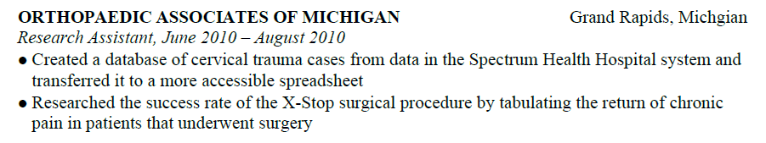
Resume Key Components
EXPERIENCE
  Present information in reverse chronological order
  Create special sections (e.g. Related Experience, Research Experience, Marketing Experience)
  Use action verbs and sentence phrases

Slide 22
Optional Categories

Slide 23
Optional Categories
OBJECTIVE
  Gives resume focus, credibility and direction
  Be concise and logical - develop different resumes for different types of jobs
  Avoid cliches such as “like working with people”
  Emphasize short term aspirations
  Typically at the top of a resume

Slide 24

Optional Categories
SKILLS
  List skills you can perform with little or no direction
  Computer – list software and computing languages
  Laboratory - list techniques, procedures and/or equipment
  Language - indicate fluency level

Slide 25
Optional Categories
Publications
  List articles published and those accepted for publication
Extra-Curricular Activities/Professional Affiliations
  List memberships and offices held
Honors/Awards/Hobbies/Interests
  Avoid listing those which may be controversial

Slide 26
Resume Formats

Slide 27
Resume Formats
CHRONOLOGICAL FORMAT
  Easy to read, most commonly used
  Presents education and work experience in reverse chronological order
Very effective if majority of education and work experience is related to objective

Slide 28
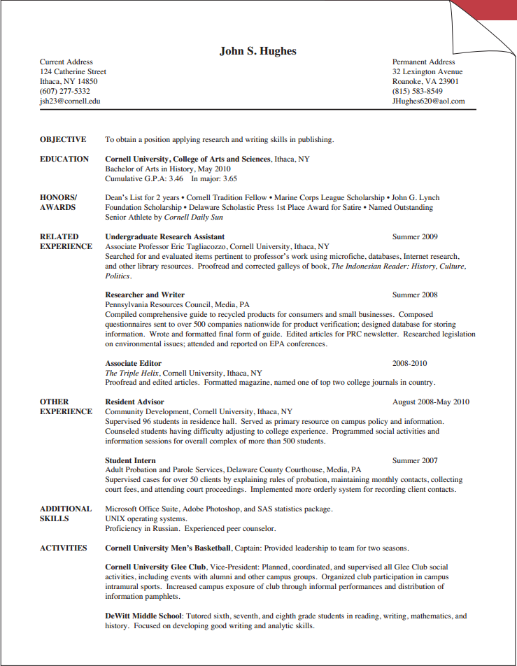
Resume Formats

Slide 29
Resume Formats
FUNCTIONAL FORMAT
  Focuses on skills and abilities, not dates of employment
  Lists skills you’ve demonstrated which are required for a particular job
Allows you to emphasize skills gained through volunteer work and extra curricular activities

Slide 30
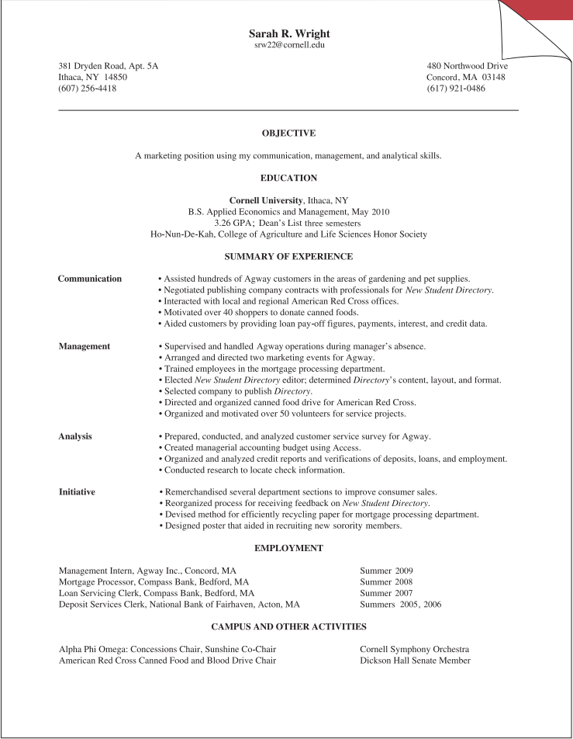
Resume Formats

Slide 31
Resume Formats
COMBINATION FORMAT
  Uses elements of Chronological and Functional
  Emphasizes skills and abilities
  Provides job/experience descriptions
Effective when job objective has multiple components (e.g. research and management, marketing and administrative)

Slide 32
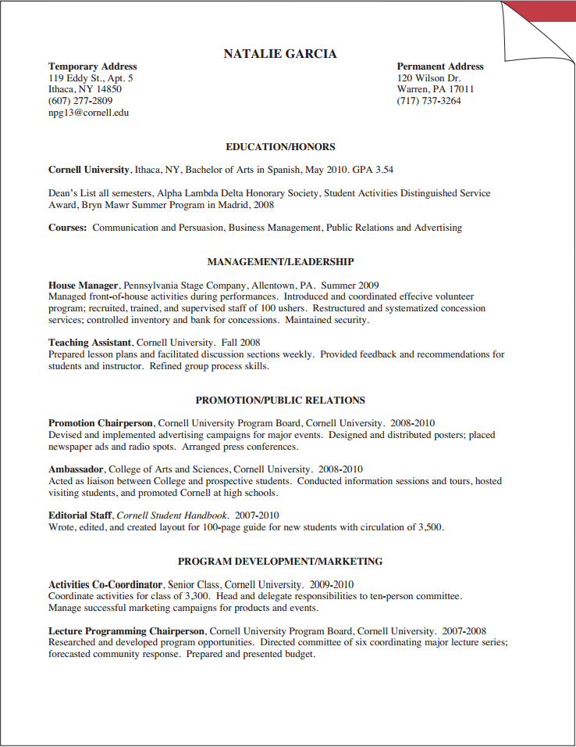
Resume Formats

Slide 33
Resume Formats
TECHNICAL FORMAT
  Used as a term to describe a resume prepared for technical positions (e.g. computer science or engineering)
  Can use any format; emphasizes technical skills such as specific computer languages, laboratory skills, etc.

Slide 34
Resume Checklist

Slide 35
Resume Review Check List
Does your resume look appealing?
Is it clearly labeled, using appropriate headings?
Does it highlight your skills and abilities?
Have you had it critiqued by others?
Have you triple checked for accuracy?

Slide 36
Follow Up
Resume, Curriculum Vitae and Cover Letter examples can be found online at:
  career.cornell.edu/story/resumes/samples.cfm
Feel free to contact any officer of SEBA if you have any questions or concerns about your resume
  Tim Shao – tss59@cornell.edu

